Slide 1
Quick Care Services
Group Members – Yash Ahire(230941220218)
Pratik Bhure(230941220041)
Project Guide –Mrs. Monika Sindhikar

Slide 2
Contents
Introduction
Choice of topic
Proposed System
Methodology
Proposed System Model
Proposed Approach
Screenshot
System Requirements
Applications
Advantages & Limitations
Conclusion
Future Scopes
References

Slide 3
Introduction
Quick Care Service allows caretaker and customer to register into the platform.
It provides customer as service receiver and caretaker as Nanny, Nurse, Babysetter, Psysiotherapist.
Customer in this application who is service receiver, who will receive service after their service order being placed.
caretaker gets a platform for getting a job and providing services.
Caretaker add their charges per hour and customer get final payable amount.

Slide 4
Choice of topic
Through this project Caretaker and Customer ensure great services.
Easy & Fast way to communicate
Quality of Service as feedback

Slide 5
Proposed System
AIM:
It will help Customers(Care Receivers)
Proposed System:
1. Digitalize Hospitality services
2. Communication can take place even through mobile
3. Eliminate Intermediates
4. Door Step quality services

Slide 6
Methodology
The objective is to create a web app that can perform the following:-
Connecting to an Caretaker through webapp.
Opening the relevant HTML page using HTTPS POST & GET methods.
Read the data logically into Caretaker and Customer.
Creating a local database.

Slide 7
Proposed System Model
There are two main modules:
Customer Caretaker
1 Home 1 Home
2 Login 2 Login
3 Patient Details 3 Caretaker Dashboard
4 Book Caretaker 4 Status
5 Requested list 5 Feedback
6 Logout 6 Patient History
7 Logout

Slide 8
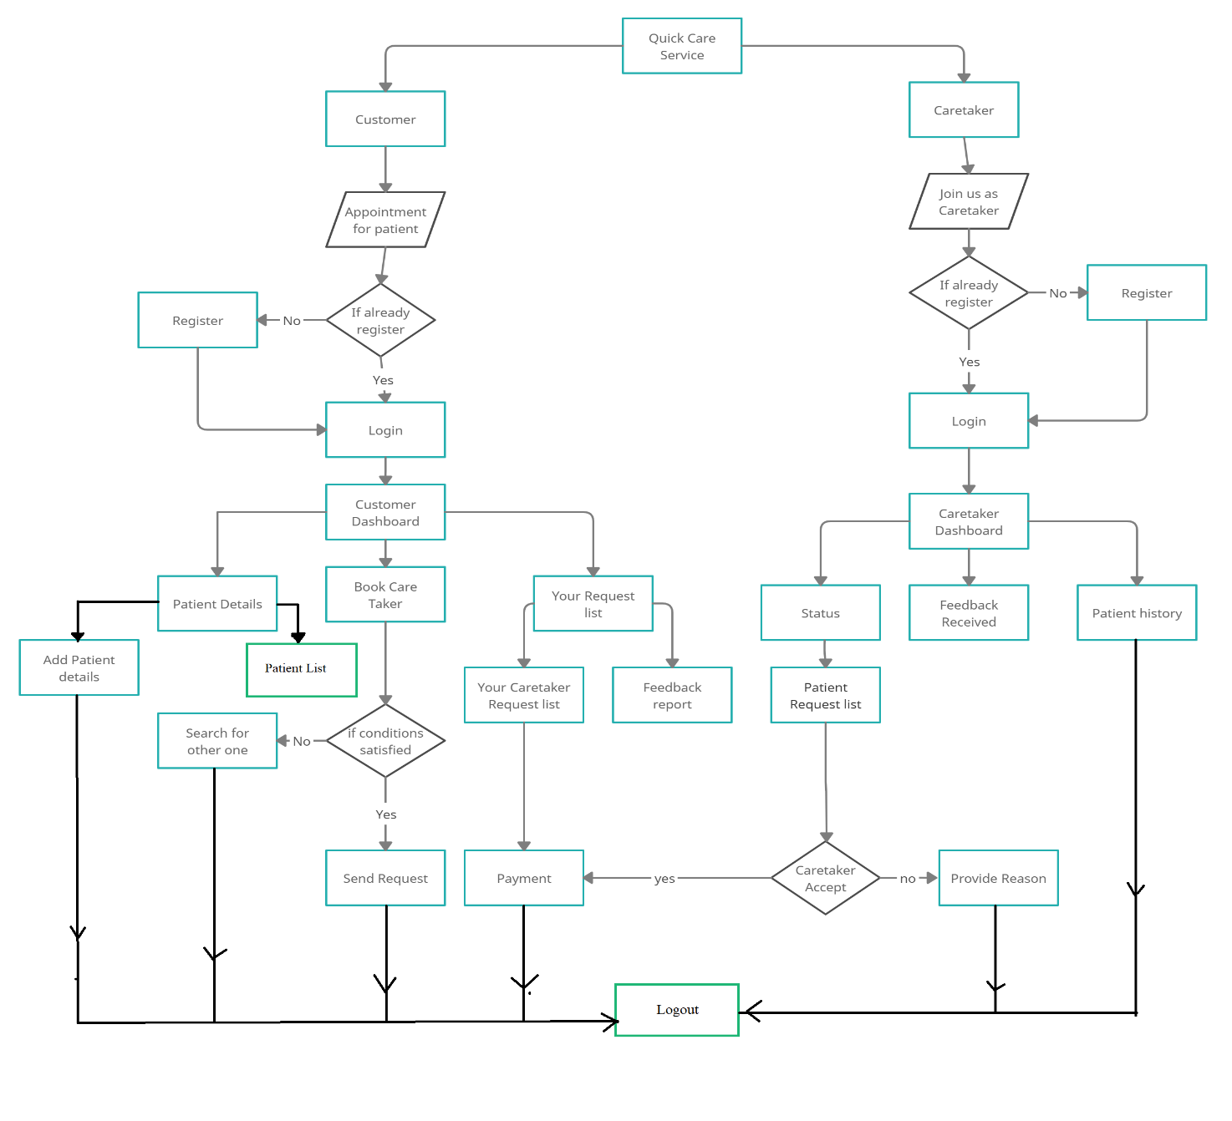
Proposed Approach

Slide 9
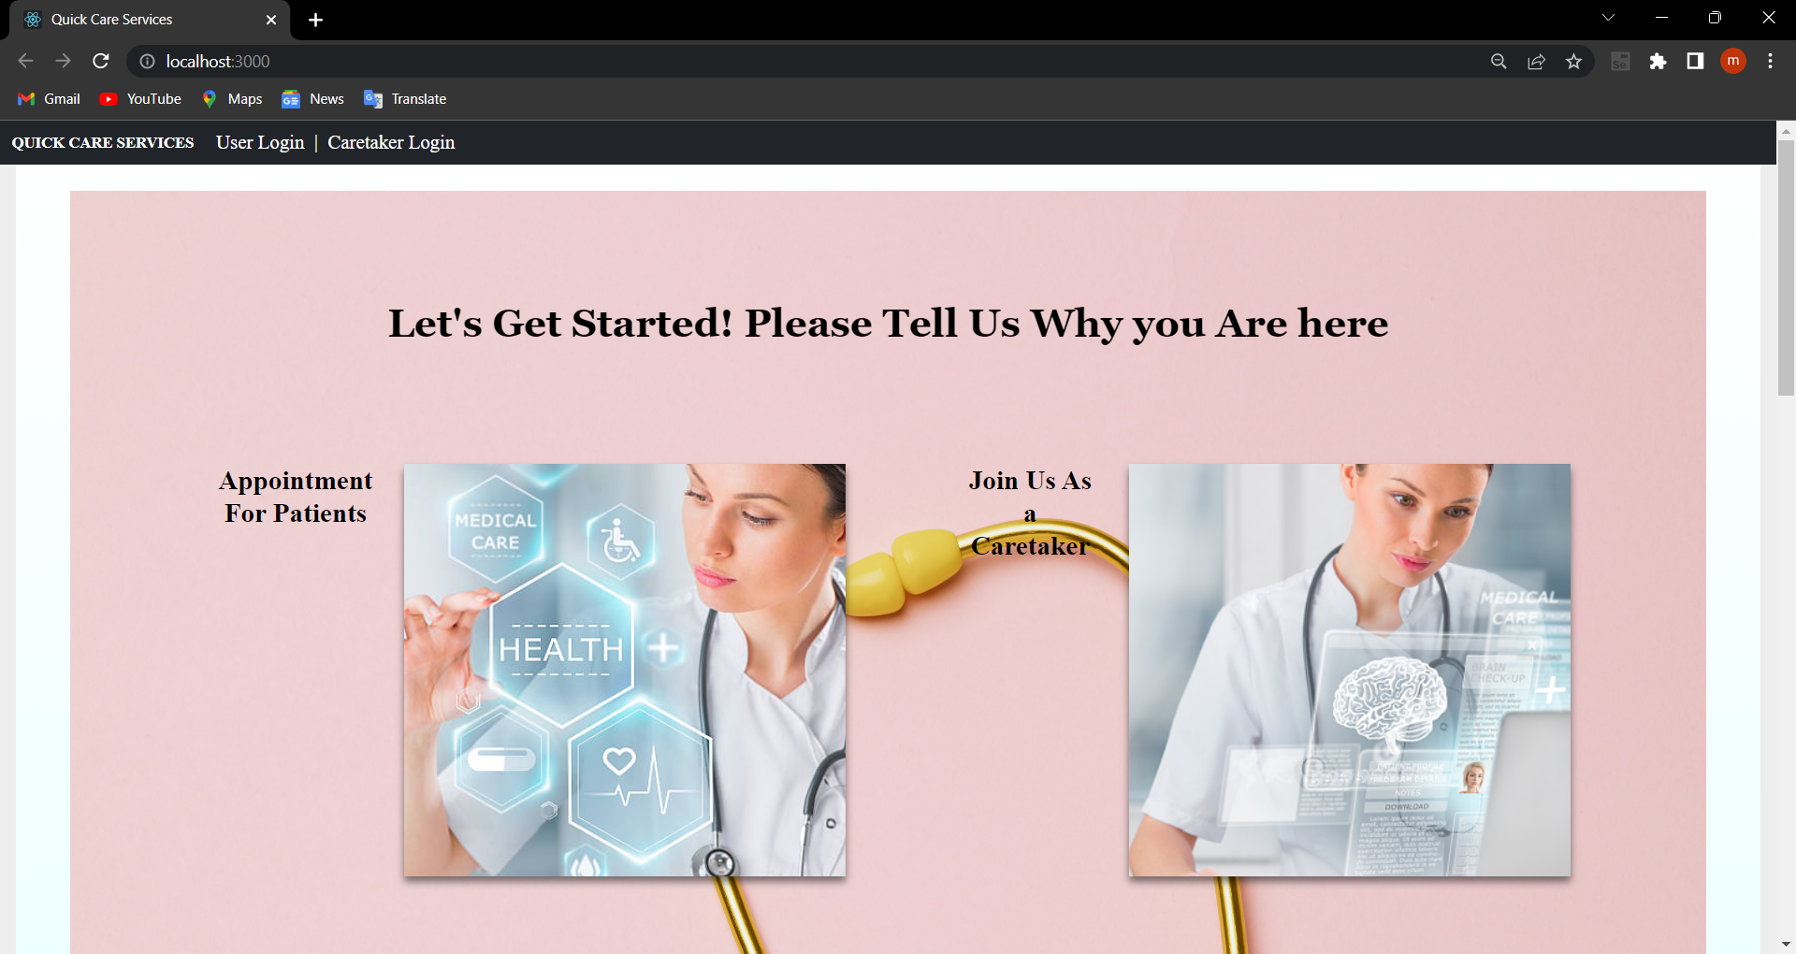

Slide 10
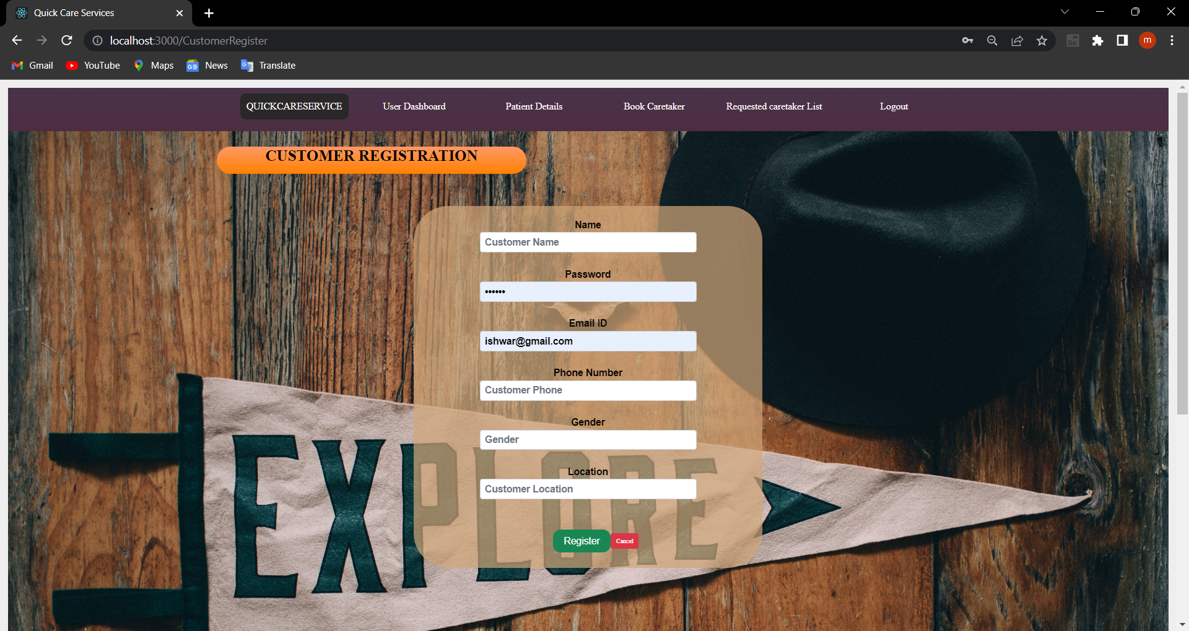
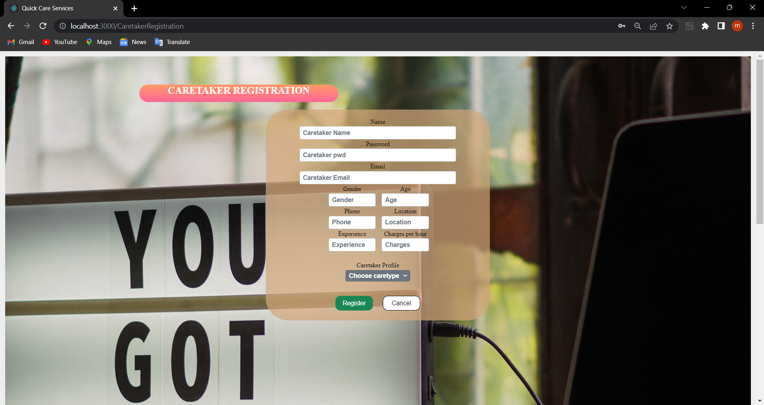
After selecting appointments for patient

Slide 11
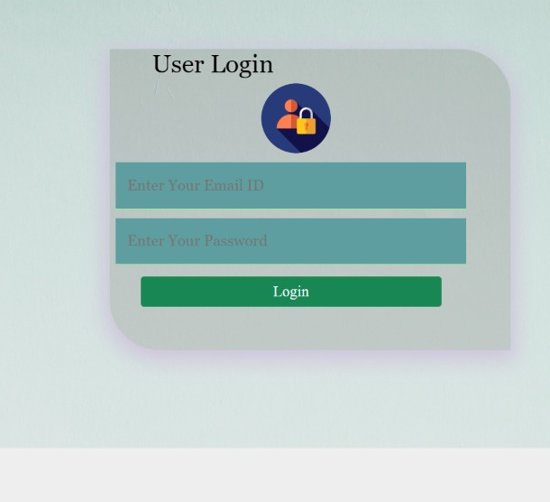
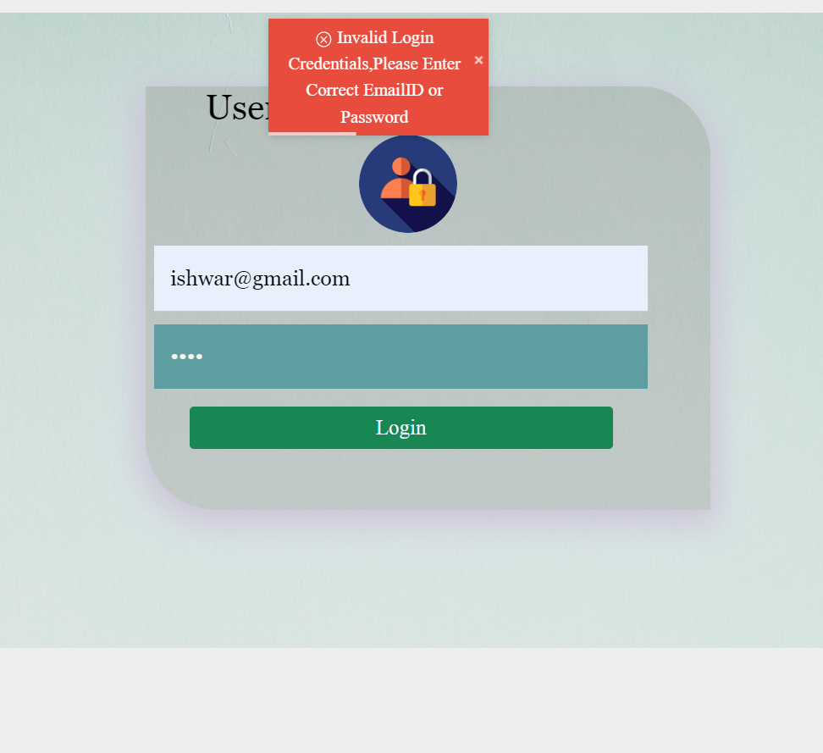
After Customer Login Customer will redirect to Customer Dashboard

Slide 12
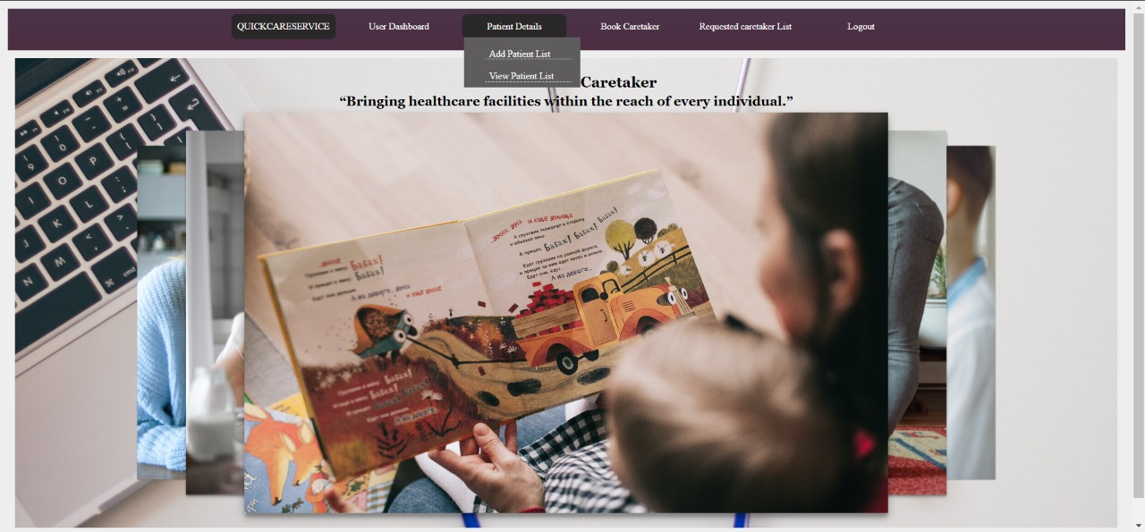
After Customer Login Customer will redirect to Customer Dashboard

Slide 13
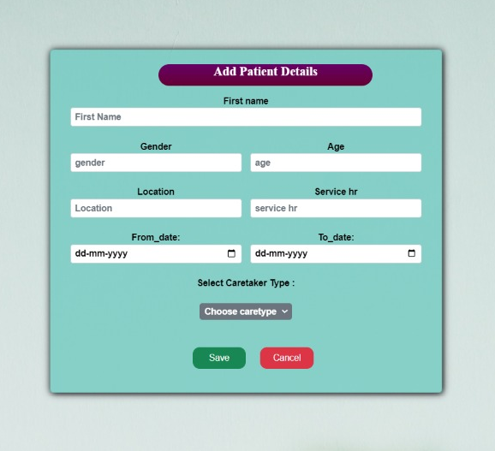
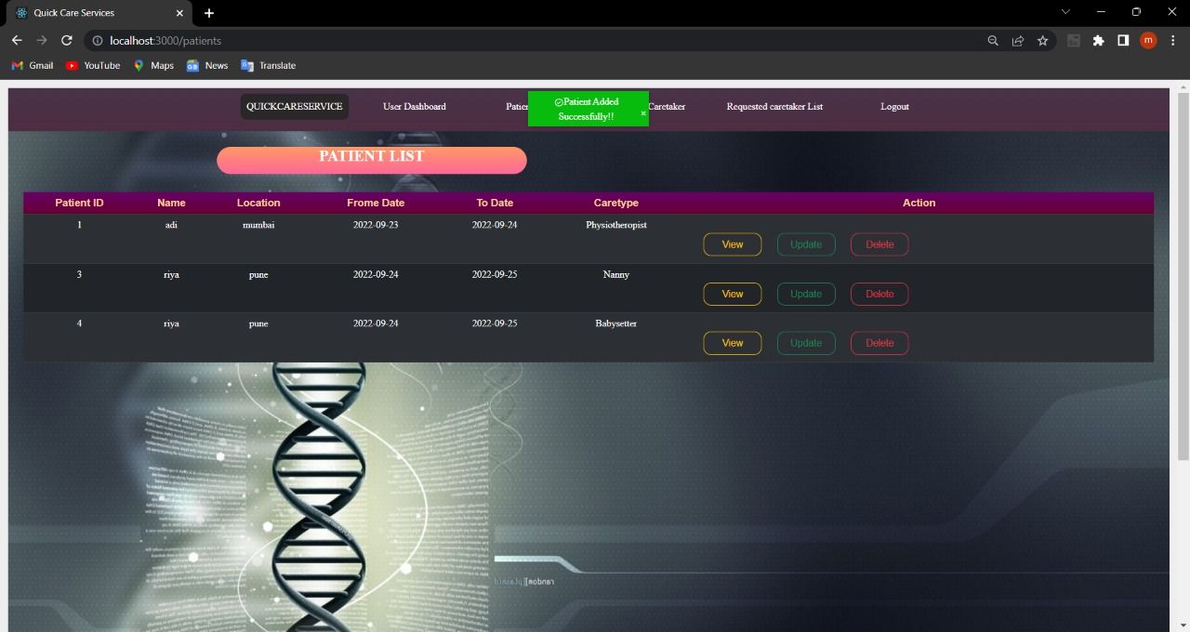
After selecting “Add new patient details” Patient details added successfully from menu bar

Slide 14
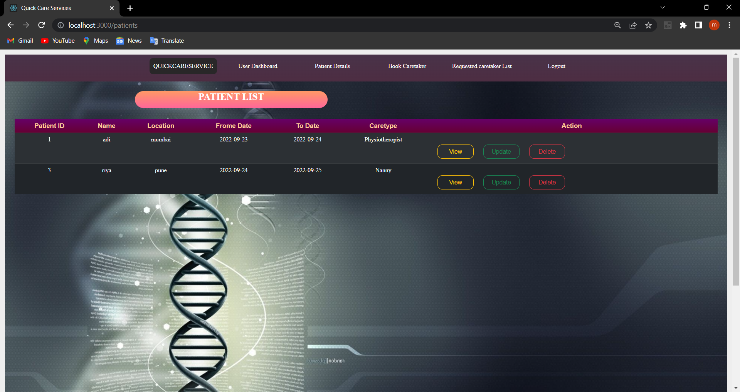
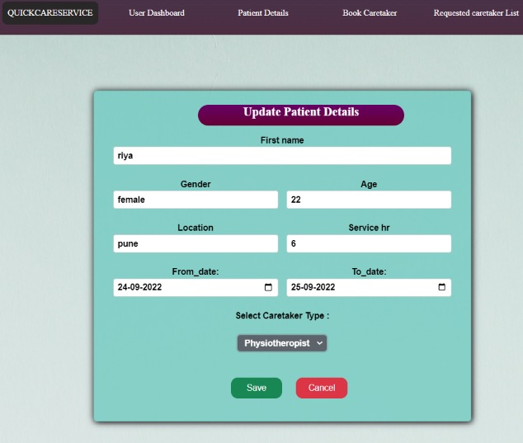
Patient List Update Patient List

Slide 15
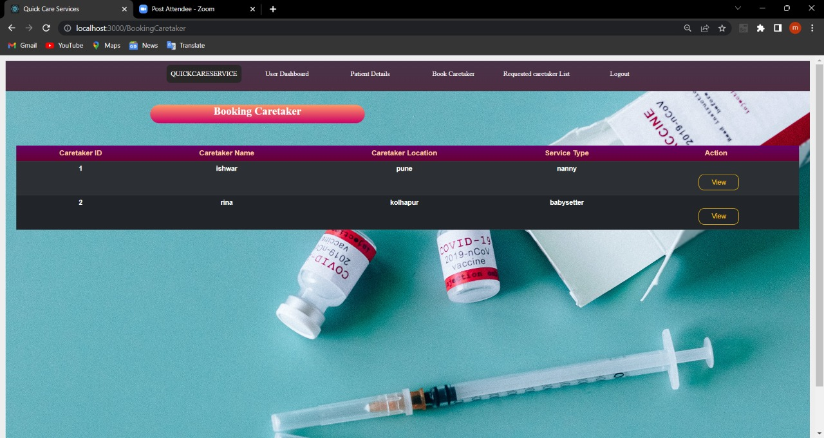
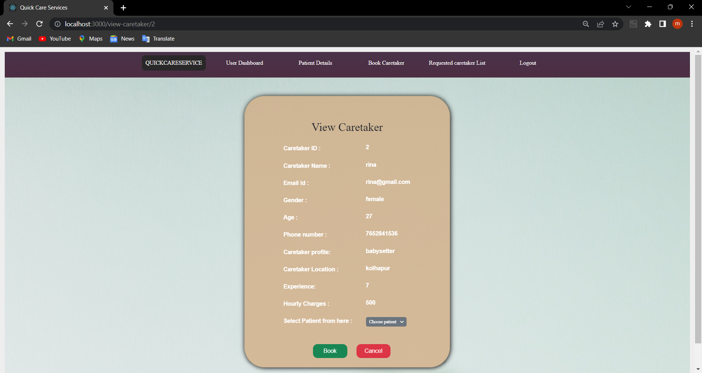
Booking Caretaker View Details of Caretaker

Slide 16
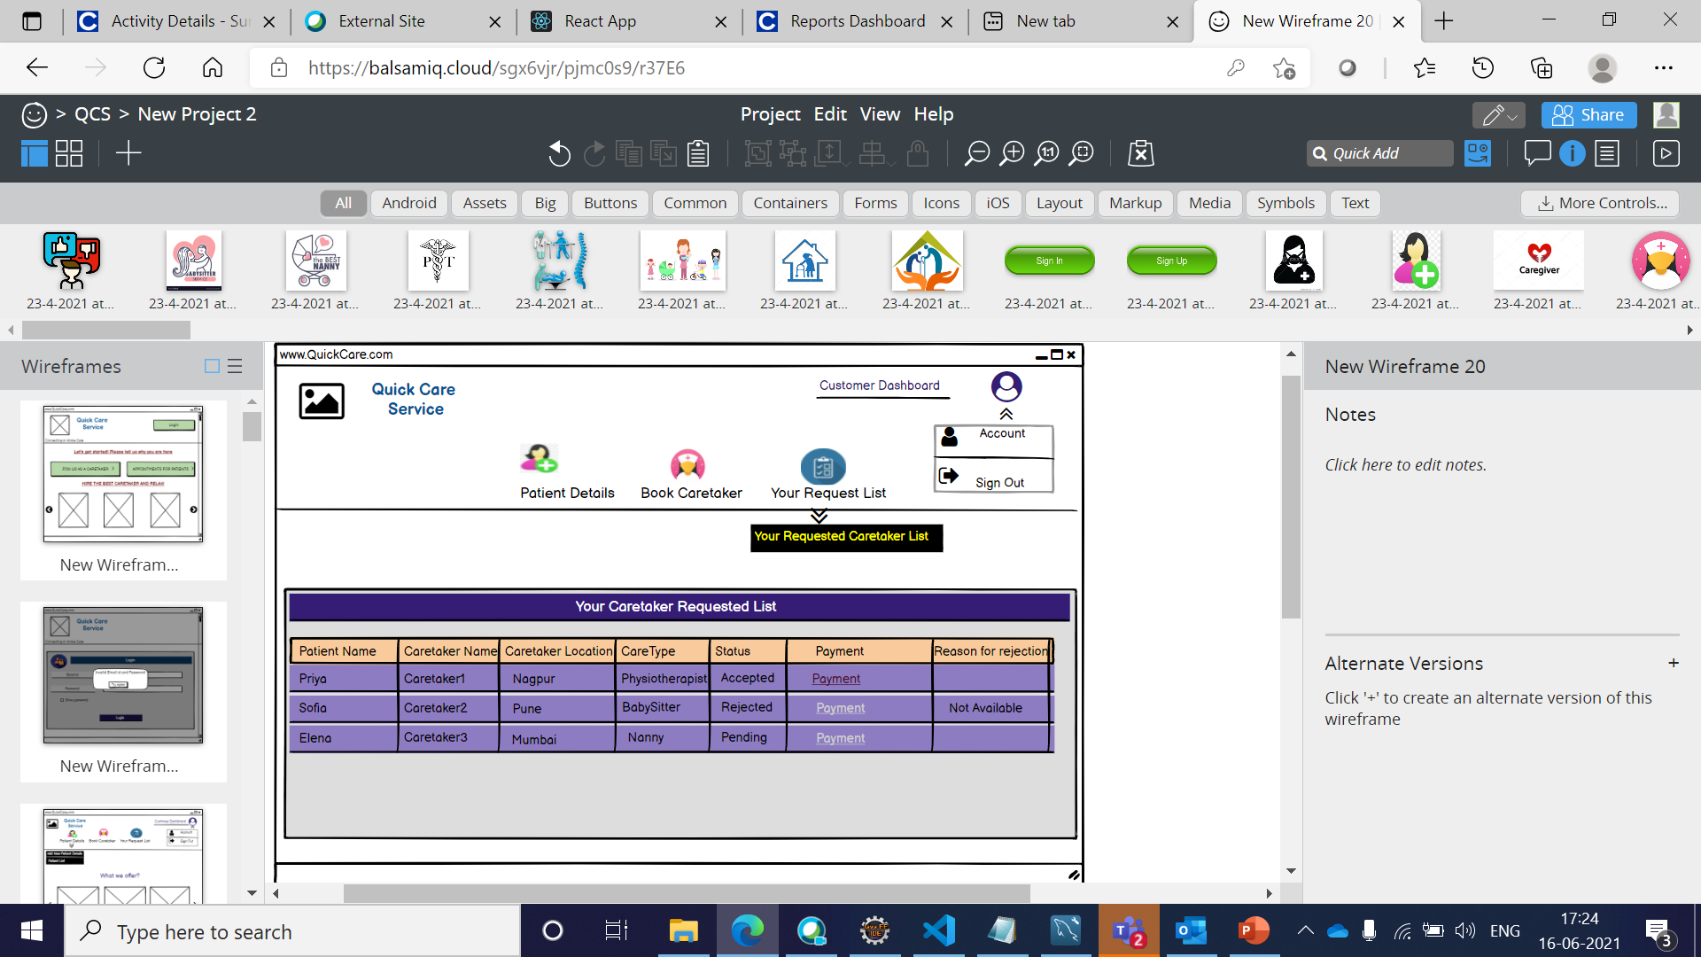
Your Requested Caretaker List

Slide 17
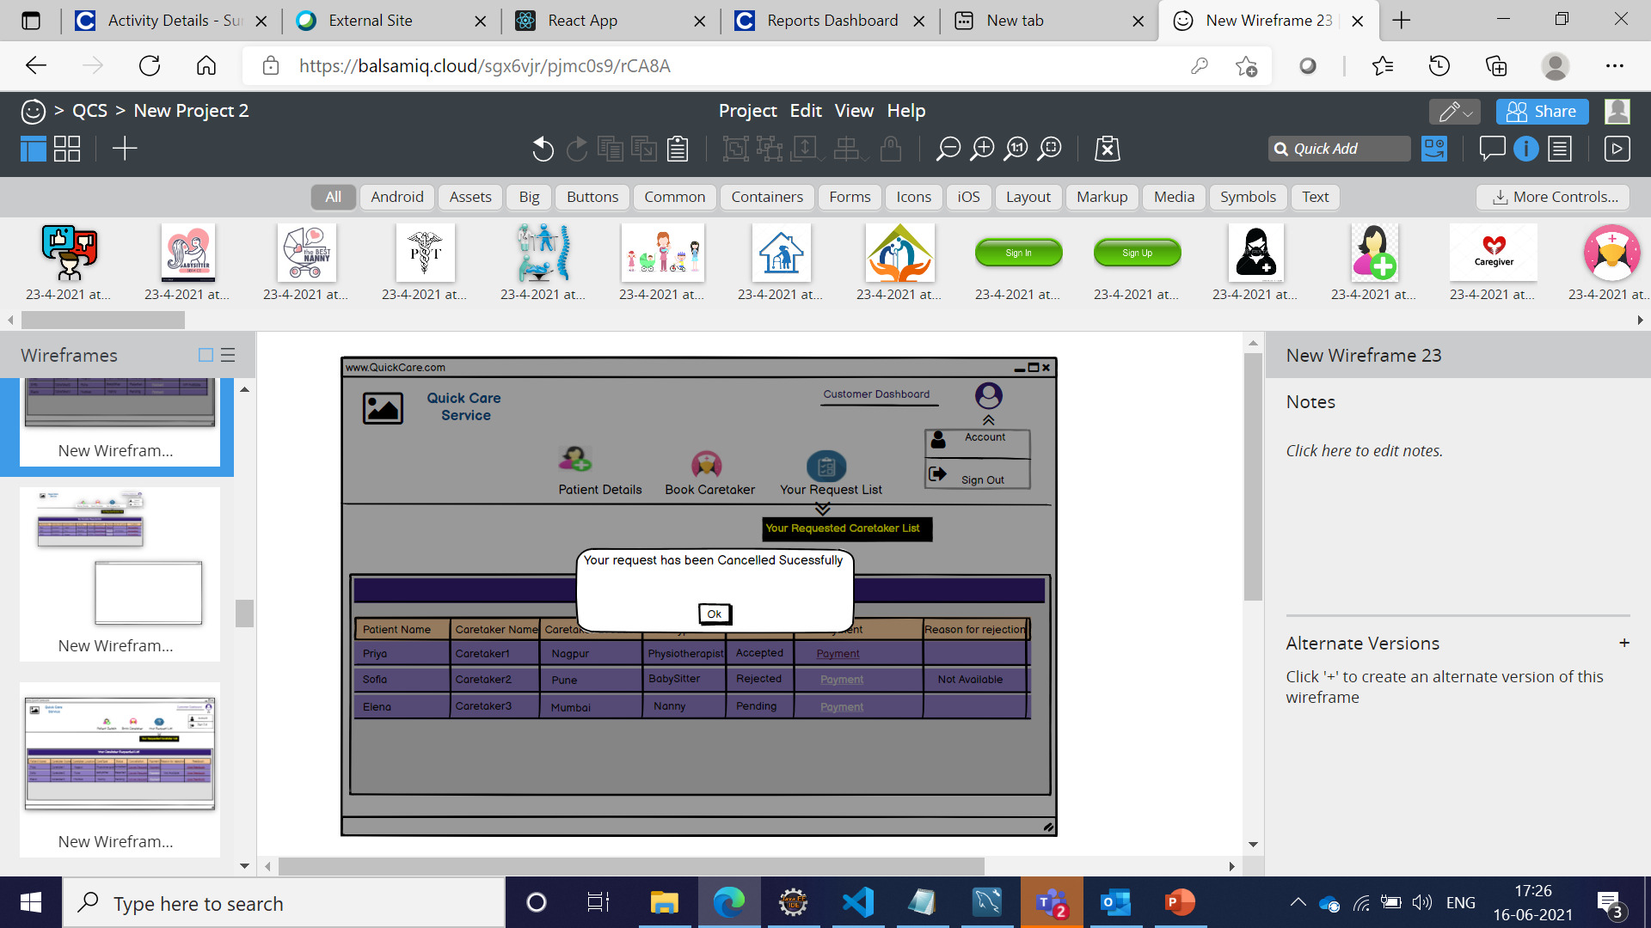
After Cancellation

Slide 18
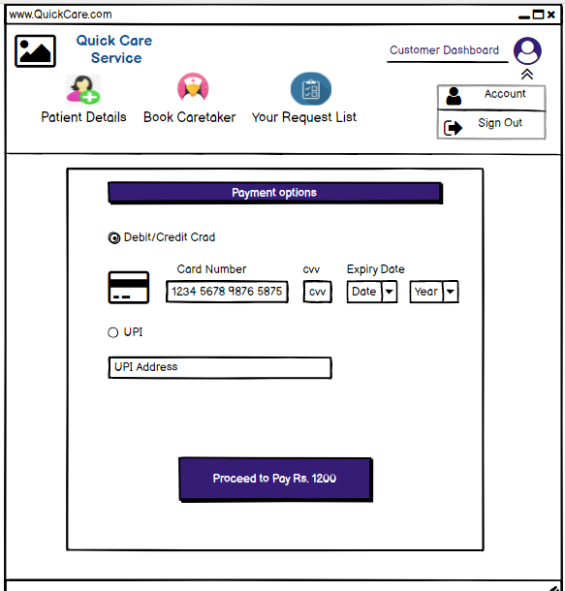
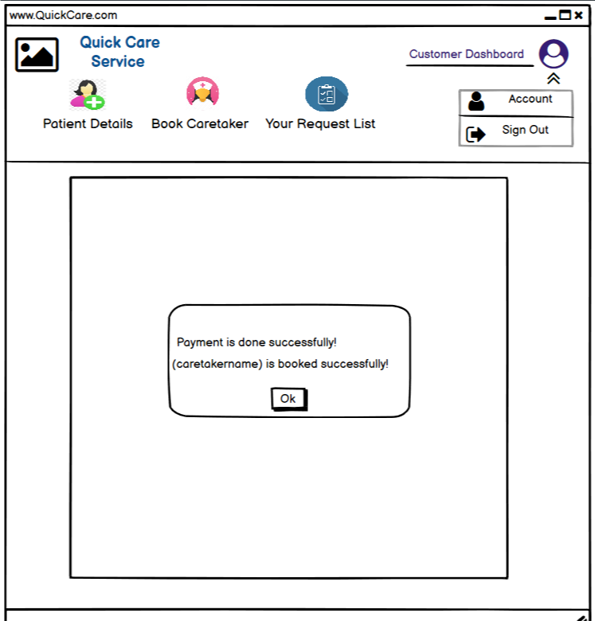
Payment

Slide 19
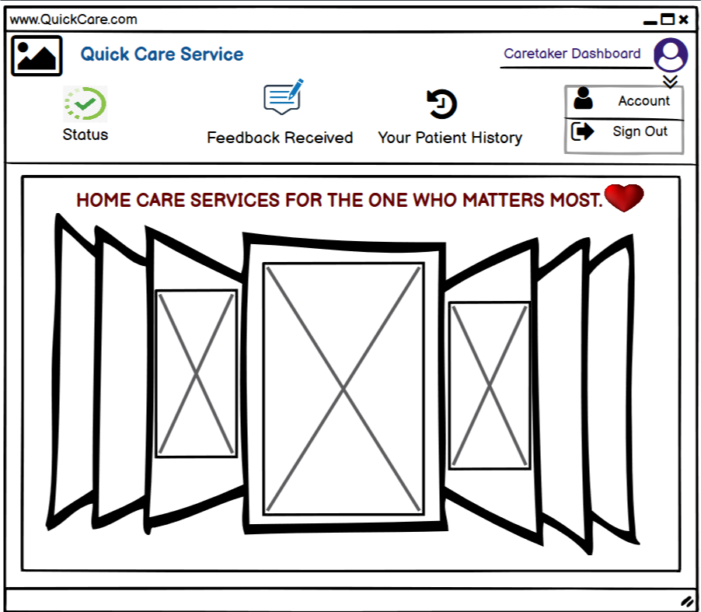
Caretaker Dashboard

Slide 20
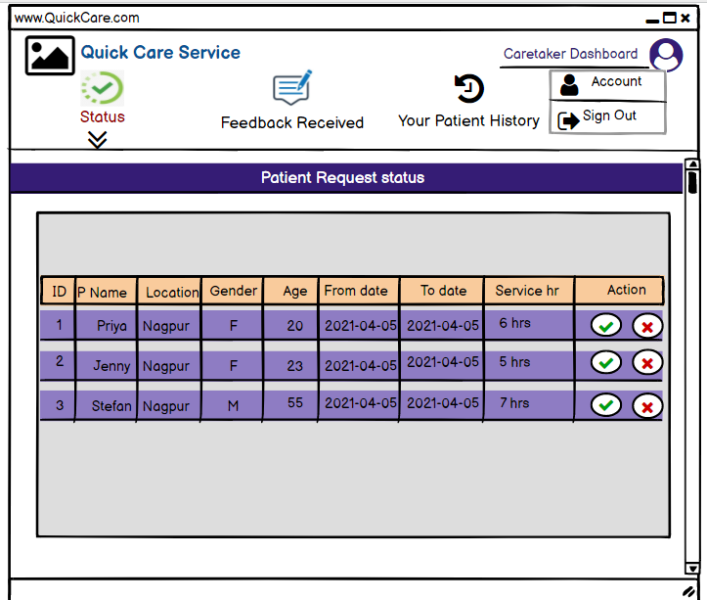
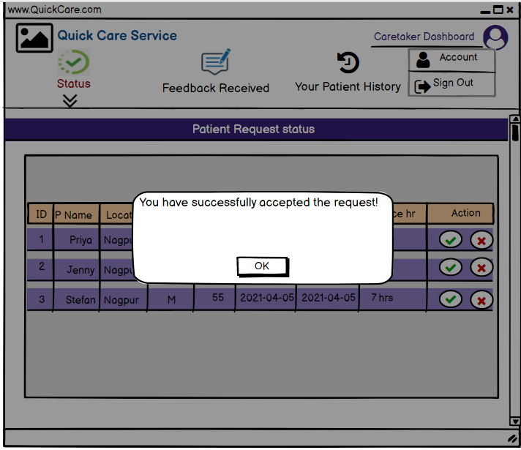
Patient Request status Patient Accepted status

Slide 21
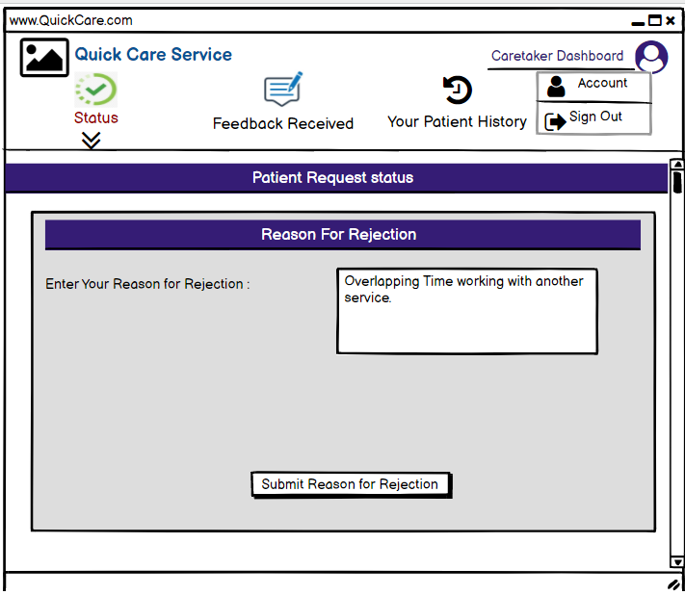
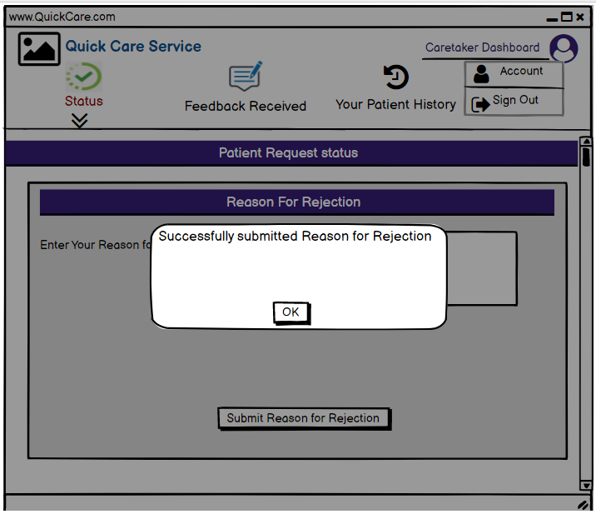
Patient Request Rejected status Reason for rejection

Slide 22
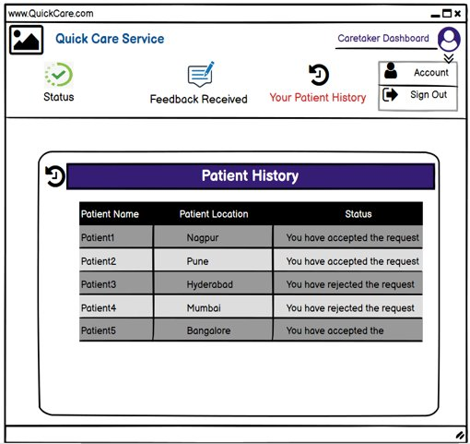
Patient history

Slide 23
System Requirements
Software Requirements:
• Windows (All Versions)
• Tomcat 9
• Eclipse, MySQL
Hardware Components:
• Processor – i5
• Hard Disk – 500 GB
• Memory – 8 GB RAM

Slide 24
Technologies Used
React : Page Layout has been designed in React.
CSS : Used for all designing part.
JavaScript : All Validation task and animations has been developed by JS.
JSP : All front end logic has been written in JSP.
JAVA : All the business logic has been written in JAVA.
MySQL : MySQL database has been used as database.
Tomcat : Project will run using Tomcat server.
Springboot:Spring Boot Web provides all the dependencies and the auto configuration needed to develop web applications.

Slide 25
Applications
Digital Care Service provider
Hospitality services

Slide 26
Conclusion
Our platform provide service to customer without wasting much time searching for the caretaker. On the other side, caretaker gets a platform for getting a job and providing services. It is easy for customer and caretaker to see details of booking and the records which gets updated every time action is done in the account.

Slide 27
Future Scope
Verification of users.
Improvement in design.
Mobile Application
UPI payment
integration of project chain of hospitals and therapy centres.
Healthcare service providers .
Chat BOT

Slide 28
References
Mrs. Kishori Khadilkar for Database.
Mrs. Kishori Khadilkar for REACT JS.
Mrs. Madhura Anturkar for Springboot,java.
https://www.slideshare.net
https://www.projectideas.co.in
A special thanks to IACSD Management who arranged extra lab time for us.

Slide 29
Thank You!

